Slide 1


Iconik software development

Slide 2
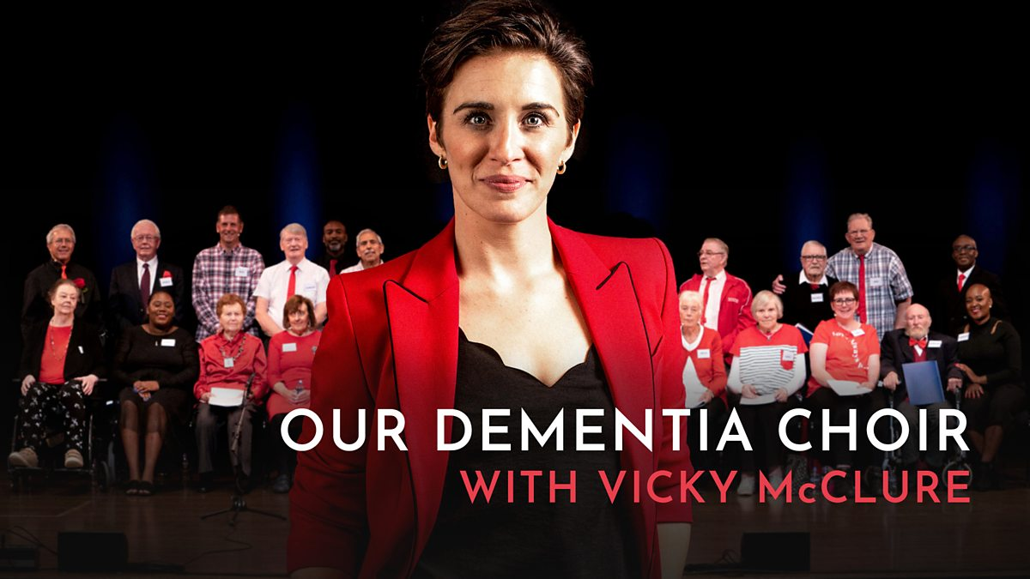
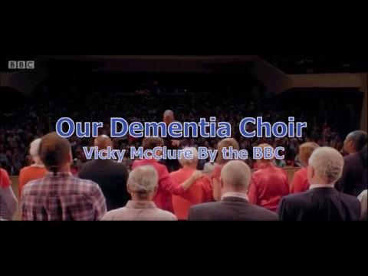
https://drive.google.com/file/d/1-KB6-MBiN3bryfAzJGTRXc_1sfc7qY1h/view?usp=sharing

Slide 4



Dementia
My Great Grandmother died of Dementia,September 2018.
My Great grandmother listened to this music

Slide 5
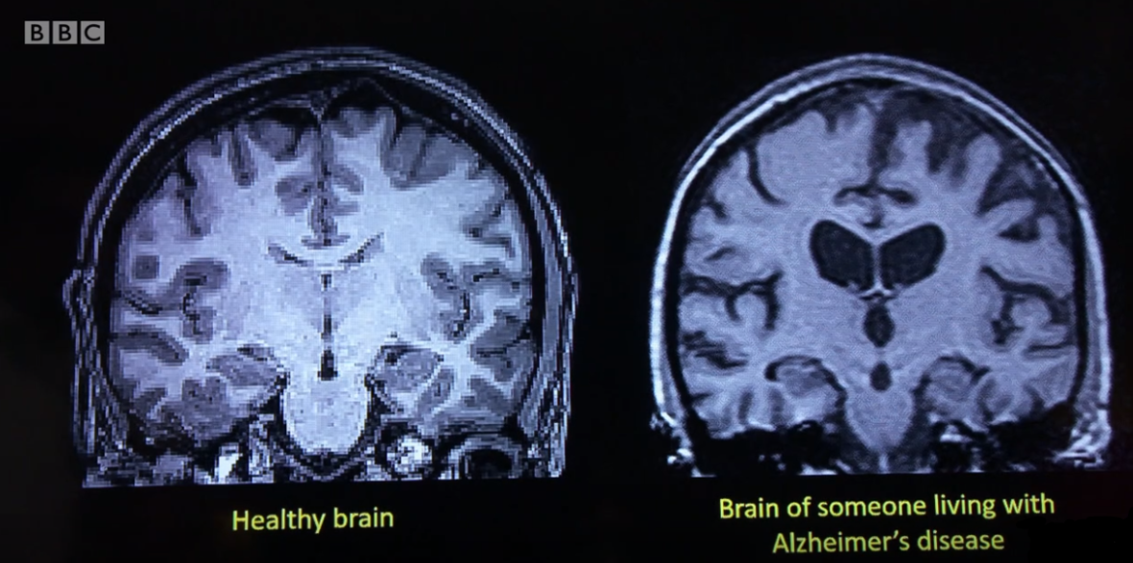
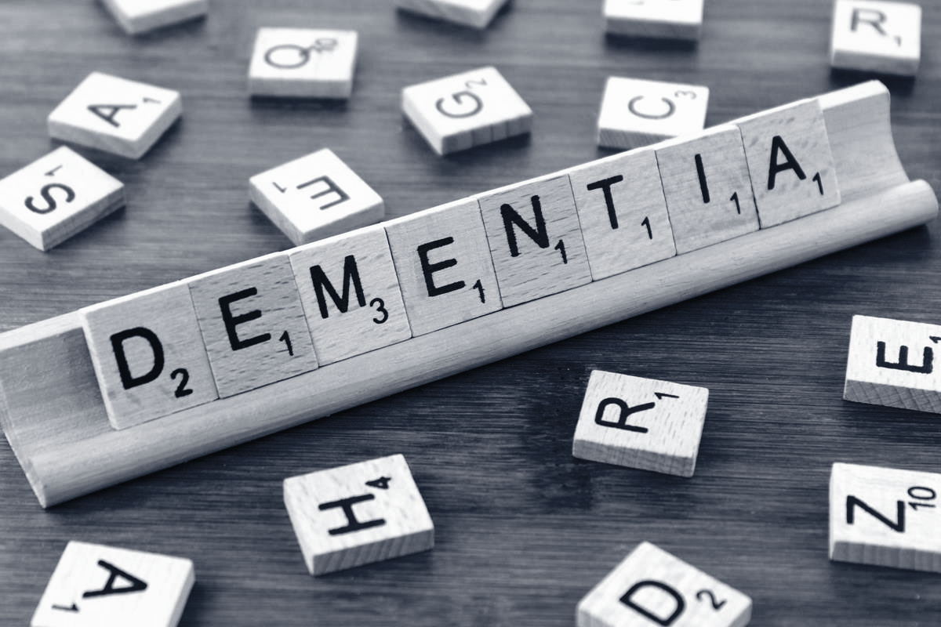
Dementia
According to Age Uk 850,000 people are affected with dementia
Estimated 1 Million people will be affected by the year
2021

Slide 6

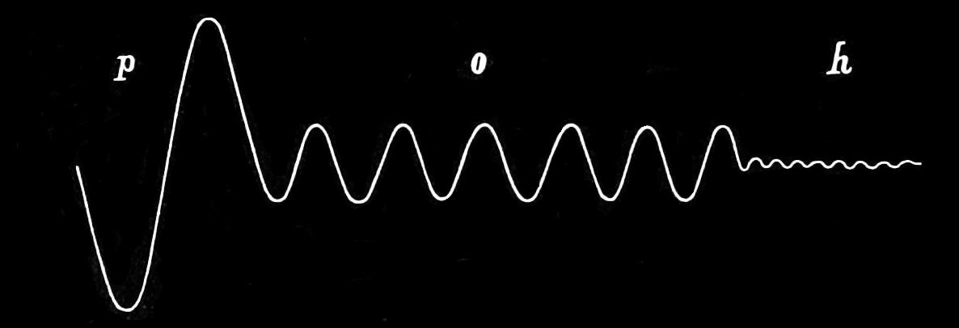
Vibrations to the music

Slide 7
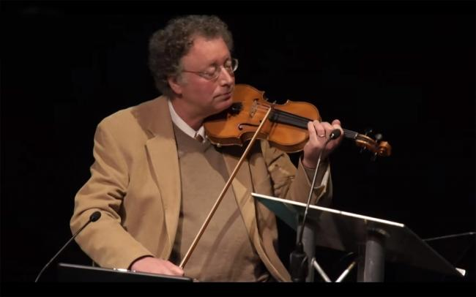
Professor Paul Robertson,

Slide 8
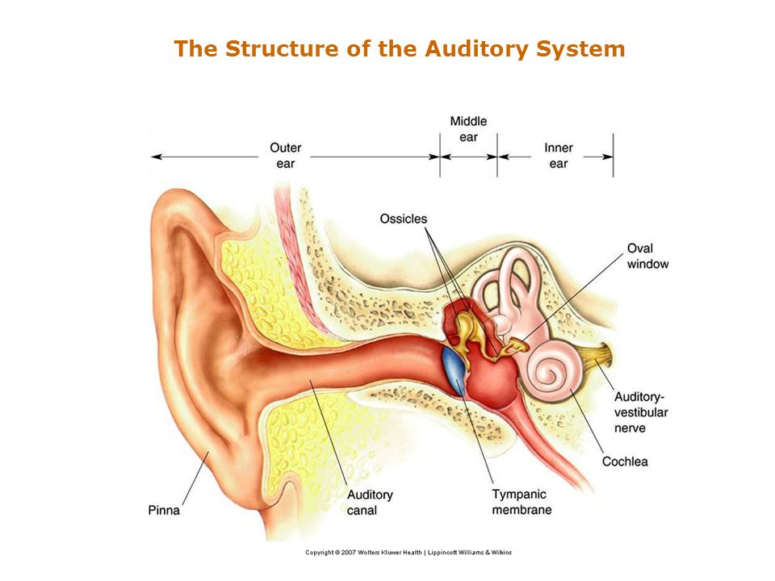

Slide 9
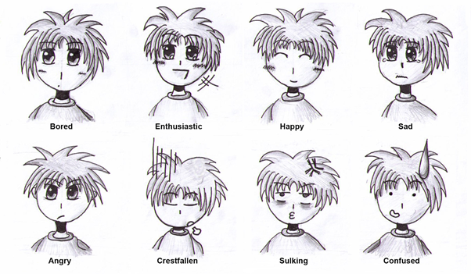
Emotions:

Slide 10

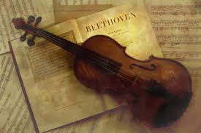



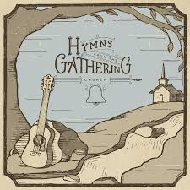



Slide 11

With thanks to Freddie Mercury music ‘We will Rock You’

Slide 12
Three-quarters

Slide 13
2x the risk

Slide 14
5x the risk

Slide 15
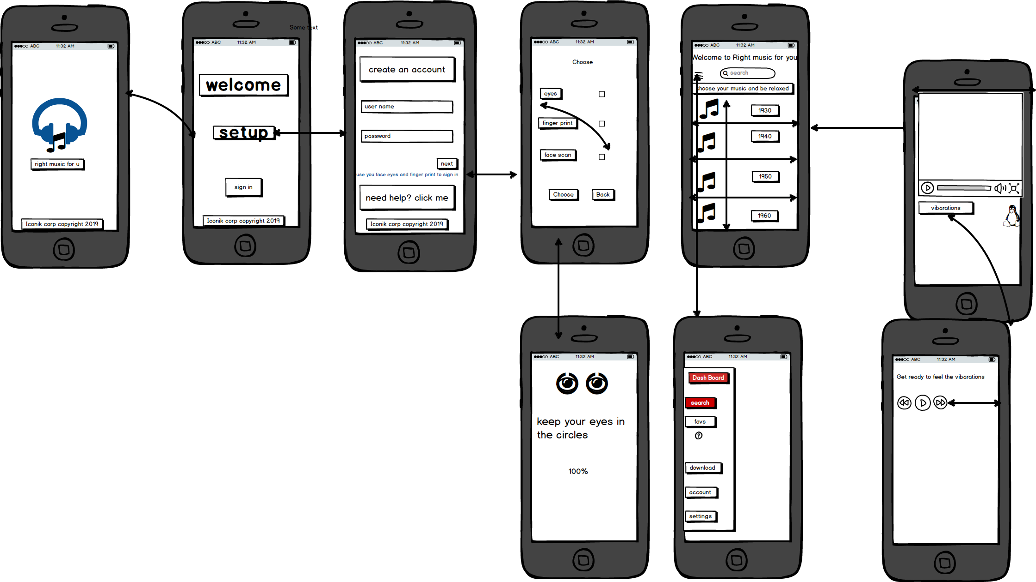

This is the wireframe for our app,and this is the dashboard

Slide 16

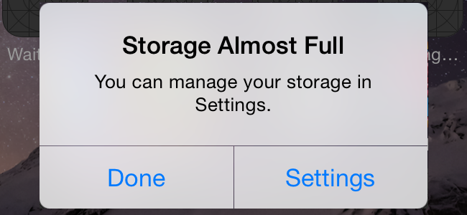
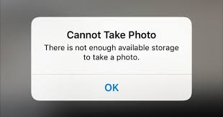
The app Storage on your mobile phone.

Slide 17


